Slide 1

KC Housing Dataset
Regression Analysis of Kansas City Housing with Price as the Target

Slide 2
Price vs Square Footage of House (apart from basement)

Slide 3
Price vs Sq. Ft. Above 2
P score of 0 indicating linear relationship
Highly predictive coefficient to follow trend
R-squared value of 0.294306 so not the best fit
Some signs of heteroscedasticity

Slide 4
Price vs Living Space (amongst nearest 15 neighbors)

Slide 5
Price vs Living Space 2
R-squared value of 0.295098 meaning not a good fit
Still highly predictive of the trend in price
P score of 0
Some signs of heteroscedasticity and therefore non normal

Slide 6
Price vs Number of Bathrooms

Slide 7
Price vs Number of Bathrooms 2
R-squared score of 0.208114 again meaning not the best fit
Yet still an excellent predictor of the direction of price
P score of 0
Clear linear and positive relationship
Again signs of heteroscedasticity

Slide 8
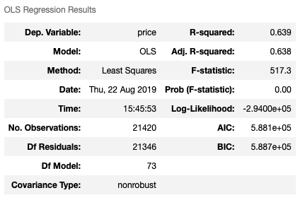
Model Performance
R-squared score is low but much higher when considering all the parameters
Coefficients include the previous 3 mentioned as well as categorical values for all the Zip Codes as well as Condition and Number of Bedrooms

Slide 9
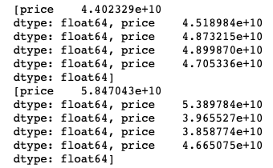
Test – Training Model
Train Mean Squared Error: 45336513948.13085
Test Mean Squared Error: 53244315653.16054
Model is fairly predictive and not a huge difference in train/test splits
Bottom image is residual results for training and testing K-fold cross-validation test

